Slide 1





Secondary classroom activities pack
Anti-Bullying Week 2025

Slide 2


Activity 1:
Understanding bullying and power
“
Definition
Behaviour by an individual or group, usually repeated over time, which intentionally hurts others either physically or emotionally.
It involves a perceived imbalance of power between perpetrator and target.
“

Slide 3

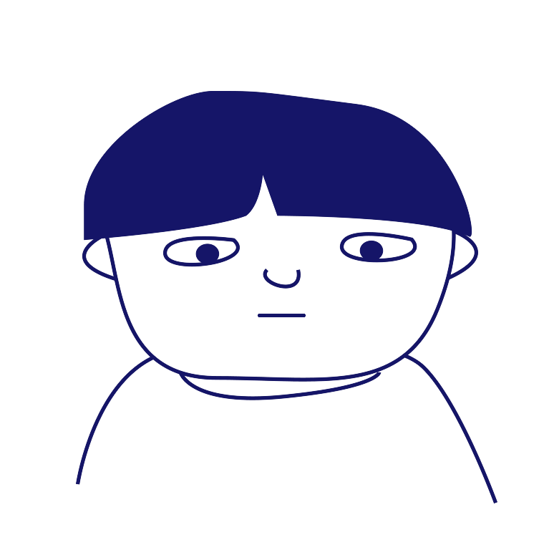

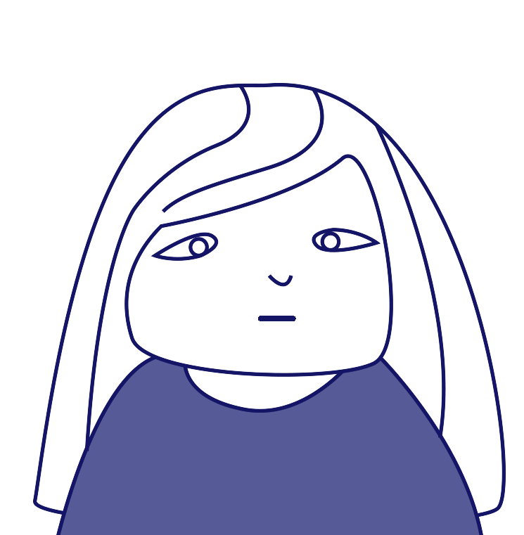
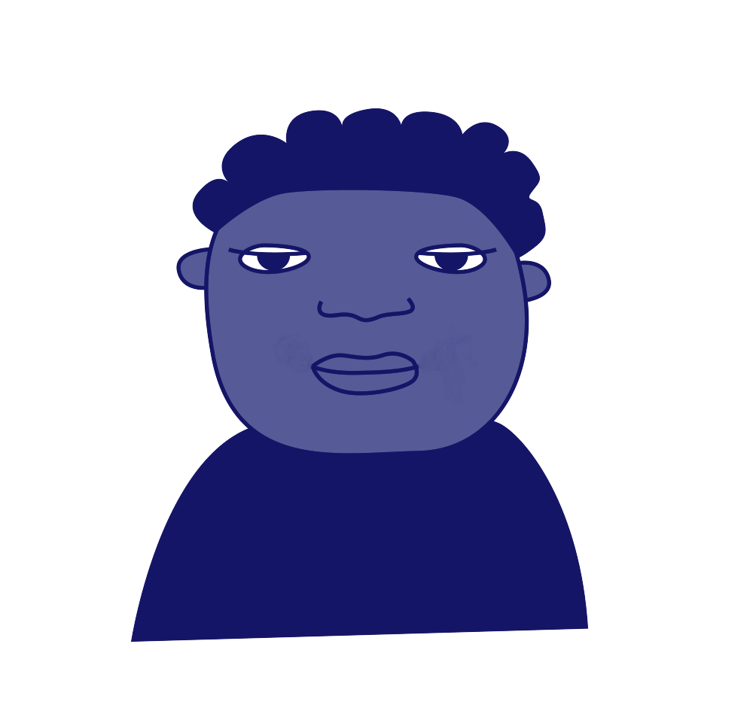
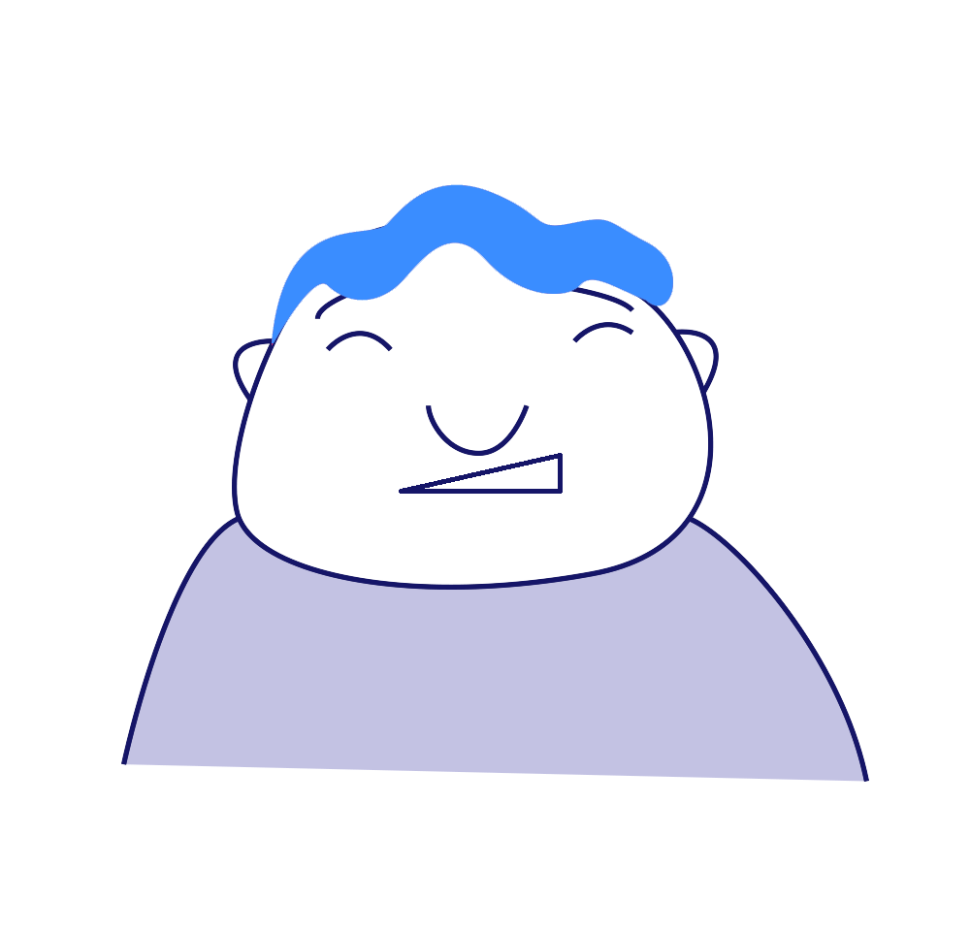
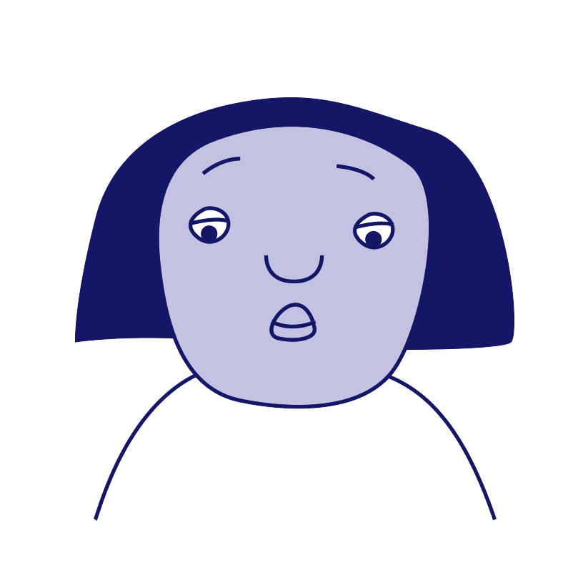
Activity 1 and 2: Finding the positive power
‘Target’
‘Ringleader’
‘Outsider’ or
Bystander’
‘Defender’
‘Reinforcer’
‘Assistant’

Slide 4

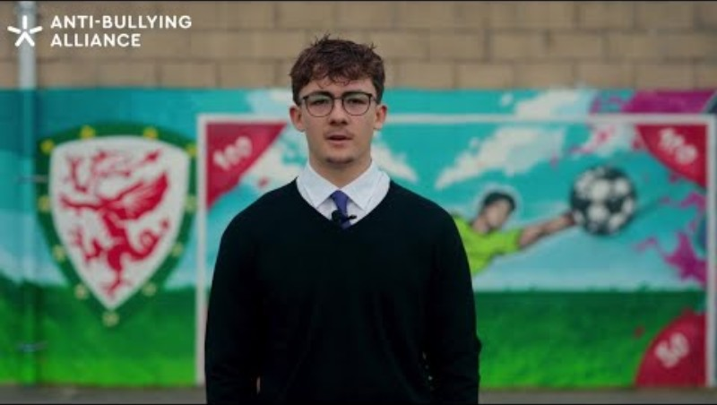

Activity 3 and 4: Voices are powerful
Notes:
https://www.youtube.com/watch?v=kFIYzT1eOB4

Slide 5

Activity 4: Kindness is brave
“
Too often we pause, unsure what to do,
But kindness is brave and it starts with you.”
“

Slide 6
Activity 4: Example scenario
You’re sitting with your friendship group at lunch.
One of your friends, Elinor, starts making fun of another classmate, Gareth, who is sitting nearby alone.
Some friends laugh along, others whisper or nudge each other, and a few say nothing at all.

Slide 7

Anti-Bullying Week 2025
Monday 10 to
Friday 14 November
Monday 10 November

