Slide 1






Primary whole-school activity
Anti-Bullying Week 2025

Slide 2

Call to action
Every year, bullying impacts the lives of countless young people
and silence helps it grow.
That’s why, this Anti-Bullying Week, we’re empowering young people to use their Power for Good to safely speak up and raise awareness when they see bullying, face to face or online.
Lasting change needs all of us. From playgrounds to
the Senedd, our homes to our phones — we all have a
part to play.
Together, we can use our Power for Good to end
bullying — for good.

Slide 3

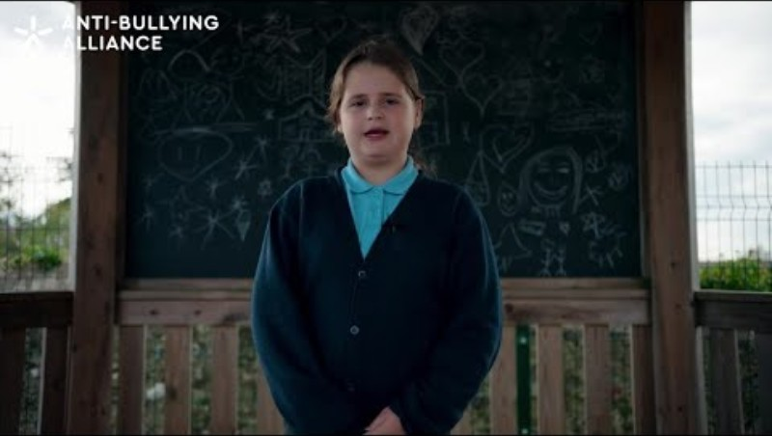


Power for Good poem
Notes:
https://youtu.be/ouX3IQPtElY

Slide 4
Recognising power
Kindness
Bravery
Listening
Making people smile
Including others
Helping

Slide 5




We all have superpowers!
(even if they don’t come with a cape!)

Slide 6


How will you use your Power for Good?

Slide 7
What’s happening this week?

Slide 8
Reporting bullying
Staff name here
Staff name here
Staff name here
Staff name here
Staff name here

Slide 9

Anti-Bullying Week 2025
Monday 10 to
Friday 14 November
Monday 10 November

