Slide 1






Primary classroom activities pack
Anti-Bullying Week 2025

Slide 2


Activity 1: What is bullying?
Part 1: What does bullying look like?
Definition
Behaviour by an individual or group, usually repeated over time, which intentionally hurts others either physically or emotionally.
It involves a perceived imbalance of power between perpetrator and target.

Slide 3
Part 2: What does bullying feel like?
Being called a mean name
Being invited to play
Being left out of a game
Being asked if you need any help
Being told you’re not good at something
Someone sharing a toy with you
Being pushed over on purpose
Someone giving you a compliment

Slide 4

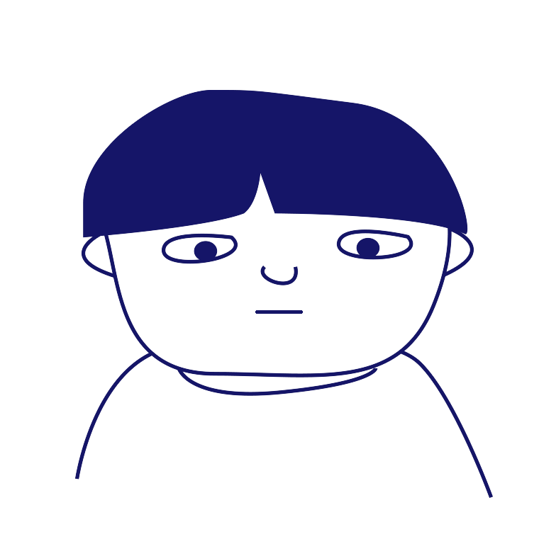
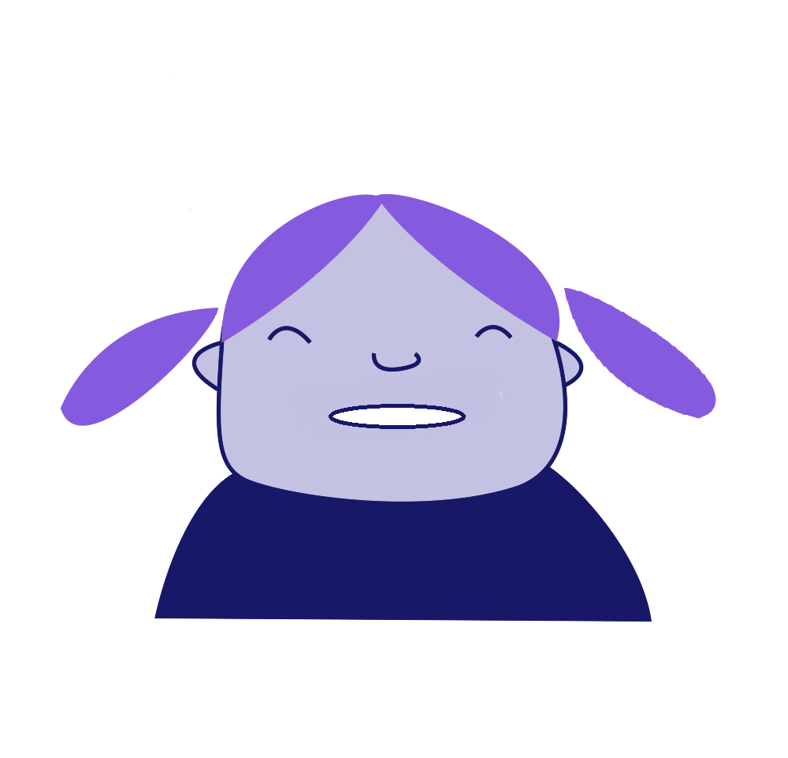
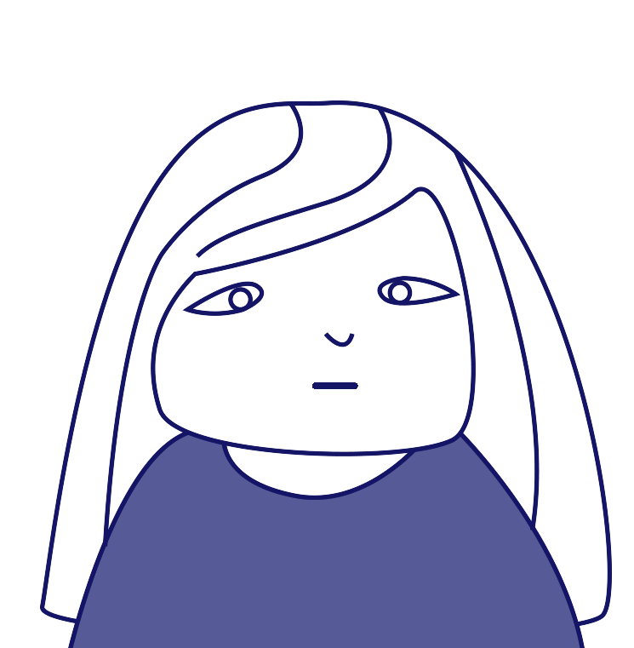
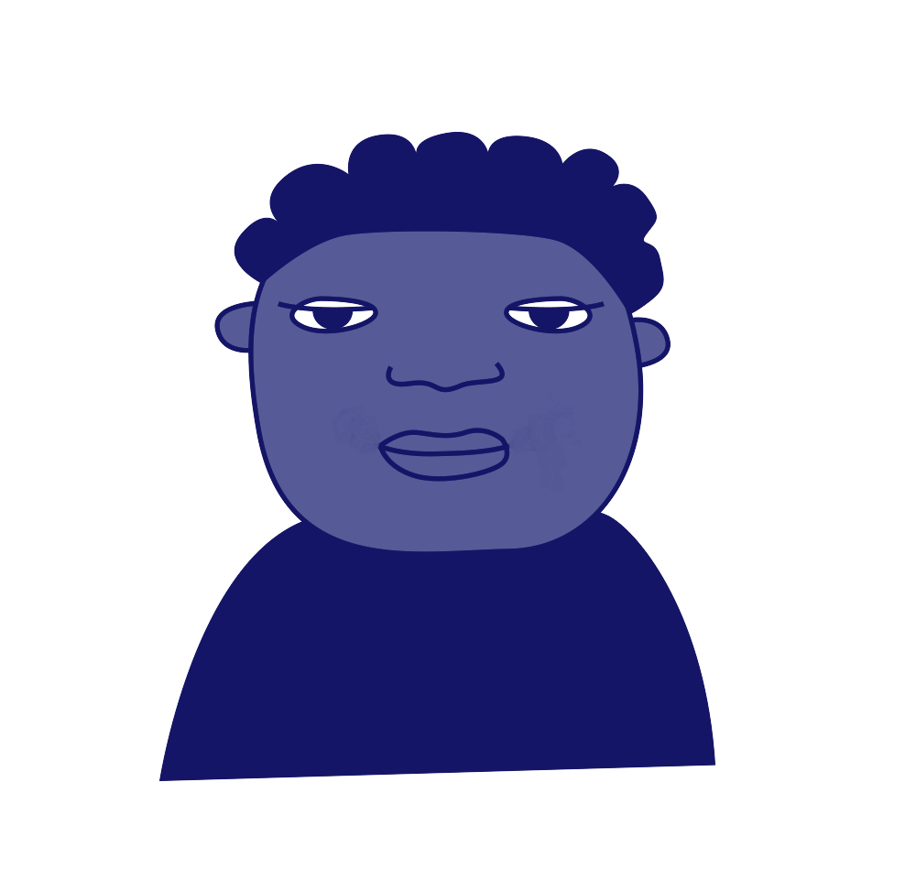
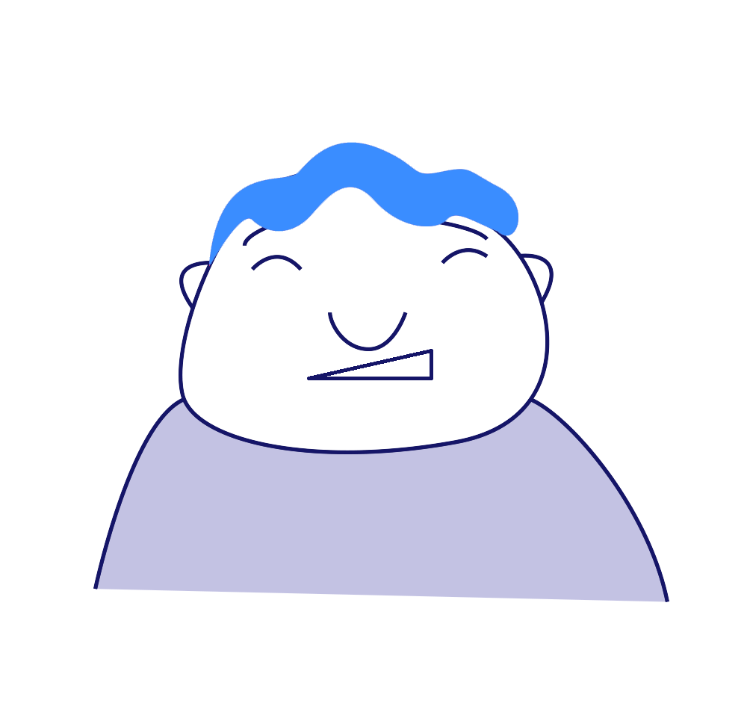
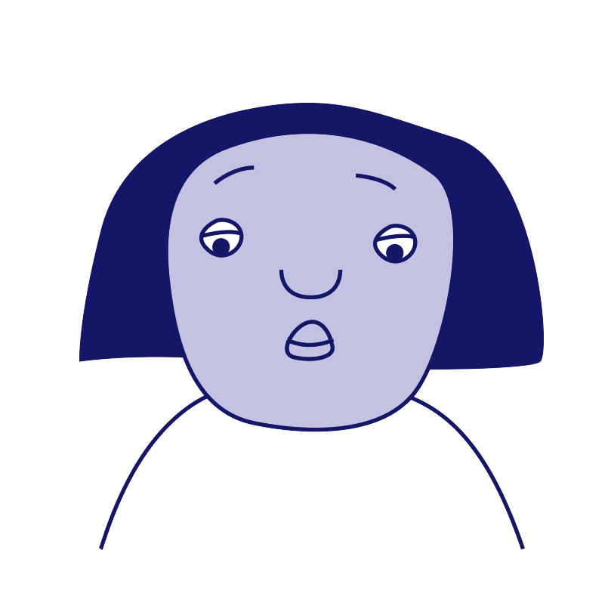
Activity 2: Roles involved in bullying
‘Target’
‘Ringleader’
‘Outsider’ or
Bystander’
‘Defender’
‘Reinforcer’
‘Assistant’

Slide 5


Activity 2: Which role am I? 1
Someone has been calling me an unkind name at breaktime

Slide 6
Activity 2: Which role am I? 2
I made up the unkind name and started using it

Slide 7
Activity 2: Which role am I? 3
I joined in with calling the unkind name when I heard it

Slide 8
Activity 2: Which role am I? 4
I laughed along when I heard the unkind name being shouted

Slide 9
Activity 2: Which role am I? 5
I heard the unkind name being used but ignored it

Slide 10
Activity 2: Which role am I? 6
I asked the target if they wanted me to help find an adult to talk to about it

Slide 11

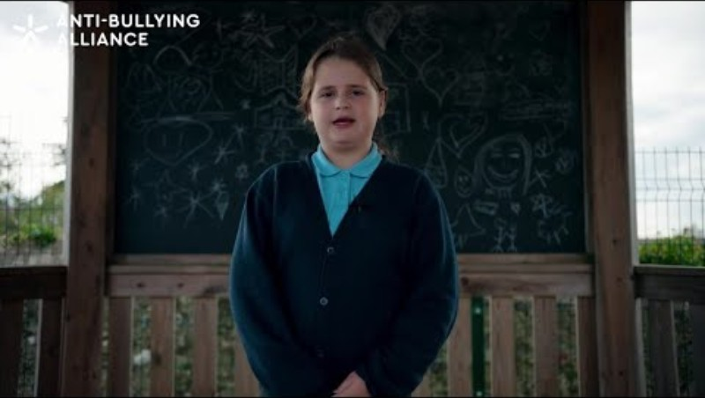

Activity 3: Power for Good poem
Notes:
https://youtu.be/ouX3IQPtElY

Slide 12

Activity 3: Why do people stay silent?
Bullying can hide, in silence, unknown.
Sometimes we worry, “What should I do?”

Slide 13
Power for Good Tips
1. Be Kind
You don’t have to shout or get involved in a disagreement to help. A simple “Are you okay?” or a kind word later can make someone feel better and you care.
2. Don’t join in with unkindness
Don’t laugh, share mean messages, or take part. Simply not joining helps stop unkindness from spreading.
3. Notice and include others
Use your power to invite someone to play or join in. Your smile or friendly face can help someone feel happy and included.

Slide 14
Power for Good Tips 2
4. Speak up safely
If you feel brave, say gently you don’t like unkind behaviour, changing the subject, or tell a grown-up you trust.
5. Take care of yourself too!
Standing up quietly for others takes courage. If it feels tough, talk to someone you trust and remember to look after yourself.

Slide 15

Anti-Bullying Week 2025
Monday 10 to
Friday 14 November
Monday 10 November

