Slide 1





Secondary whole-school activity
Anti-Bullying Week 2025

Slide 2

Call to action
Every year, bullying impacts the lives of countless young people
and silence helps it grow.
That’s why, this Anti-Bullying Week, we’re empowering young people to use their Power for Good to safely speak up and raise awareness when they see bullying, face to face or online.
Lasting change needs all of us. From playgrounds to
parliament, our homes to our phones — we all have a
part to play.
Together, we can use our Power for Good to end
bullying — for good.

Slide 3

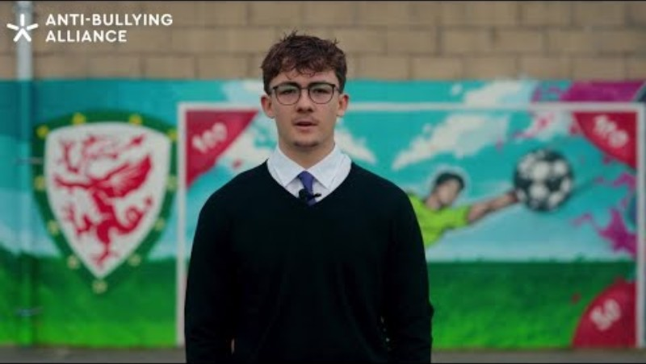


Power for Good poem
Notes:
https://www.youtube.com/watch?v=kFIYzT1eOB4

Slide 4
Discussion points
In our school, where do young people have power?
What does it look like when that power is used in a negative way?
What does it look like when it is used in a positive way?

Slide 5
Discussion points 2
Can you think of a time you could have used your power for good, but didn’t? What stopped you?
What does “using your power for good” mean to you personally?

Slide 6


How will you use your
Power for Good?

Slide 7


Our plans for
Anti-Bullying Week and important reminders

Slide 8
Reporting bullying
Staff name here
Staff name here
Staff name here

Slide 9

Anti-Bullying Week 2025
Monday 10 to
Friday 14 November
Monday 10 November

