Slide 1








ANTI-BULLYING WEEK 2025
Monday 10th to
Friday 14th November
Monday 10th November

Slide 2



Notes:
https://youtu.be/lO6599wP390

Slide 3


WHAT IS BULLYING?
“
Anti-Bullying Alliance’s Definition:
The repetitive, intentional hurting of one person or group by another person or group, where the relationship involves an imbalance of power. Bullying can be physical, verbal or psychological.
It can happen face to face or online.
“

Slide 4

DISCUSSION
Why does bullying often involve an imbalance of
power?
How might the person being bullied feel powerless?
How can bystanders reclaim power and use it for
good?

Slide 5


POWER MAPPING ACTIVITY

Slide 6
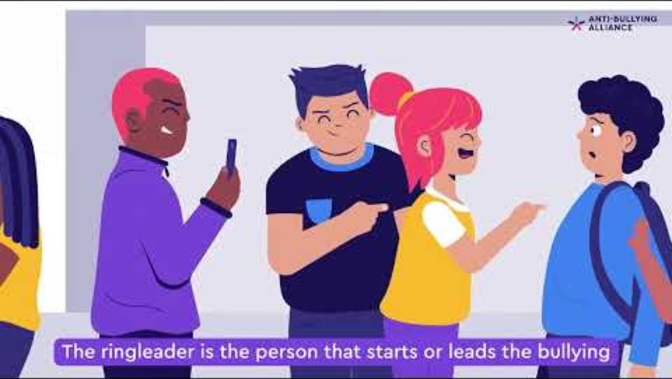
Notes:
https://youtu.be/XcPzUW2GaiY

Slide 7
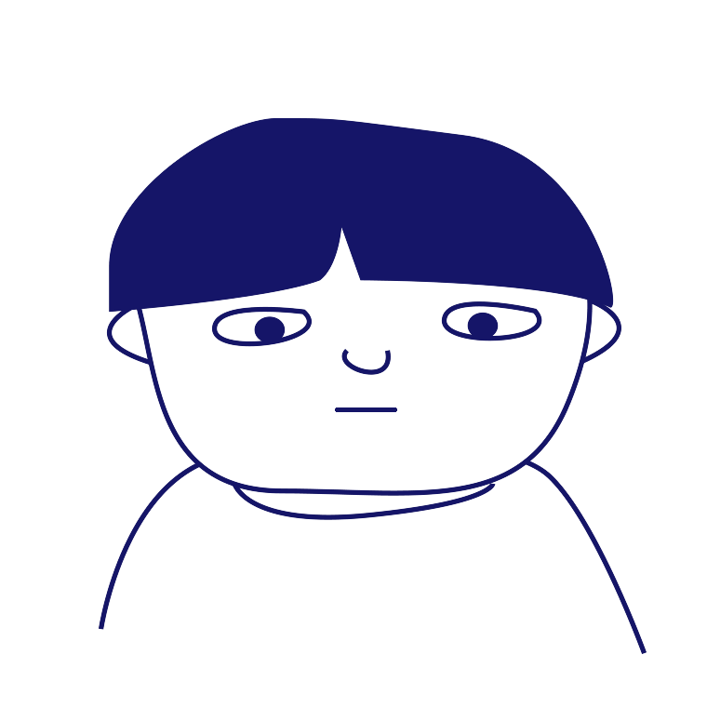
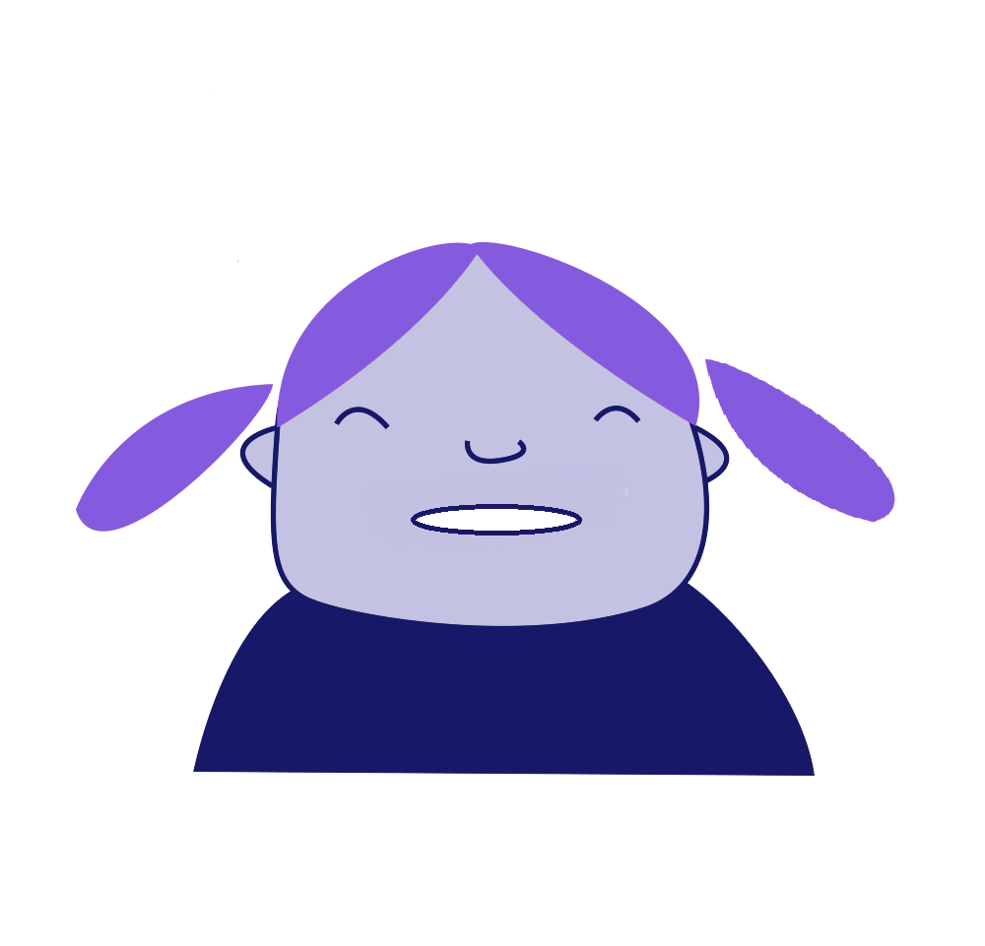
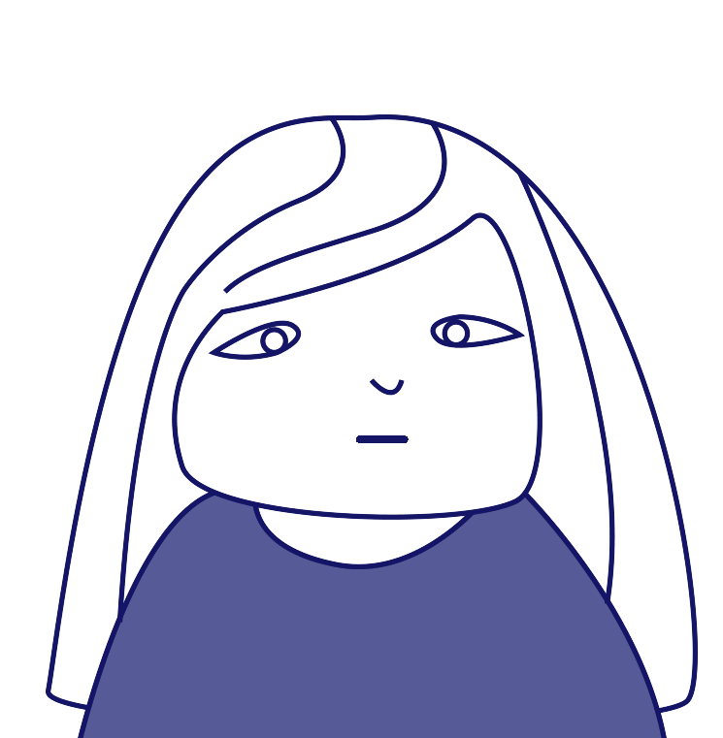
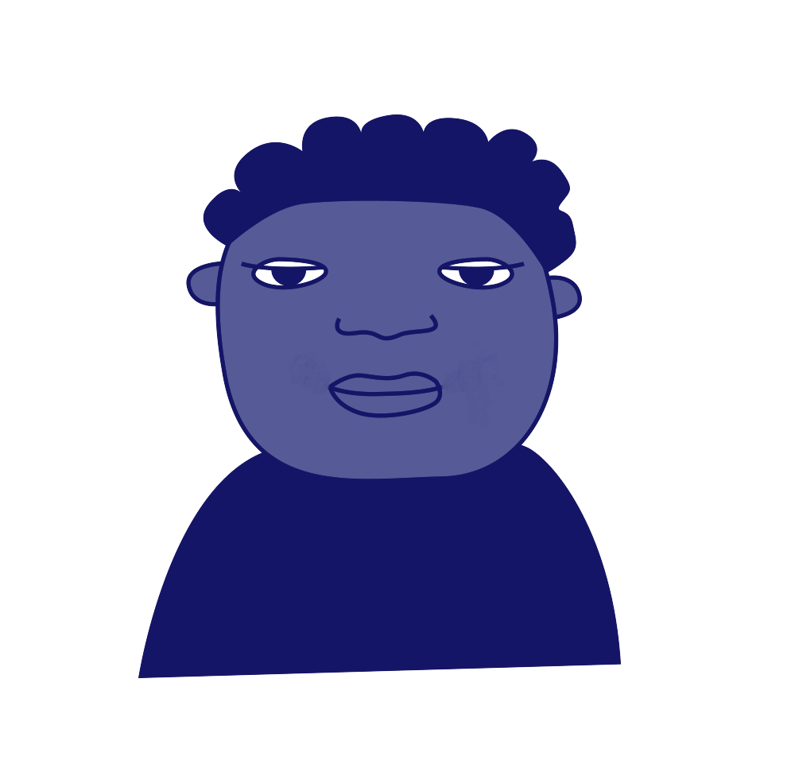
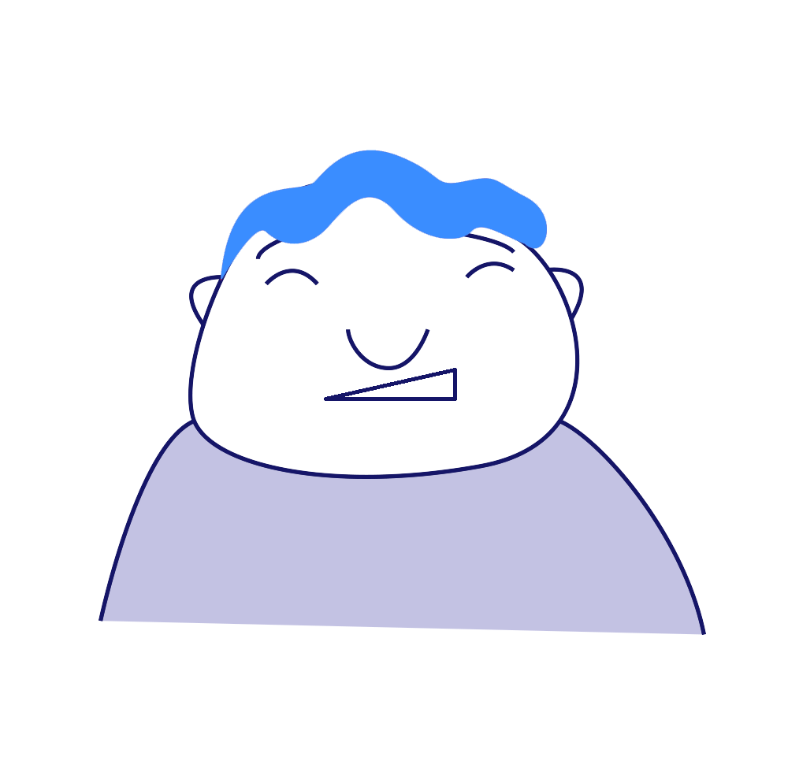
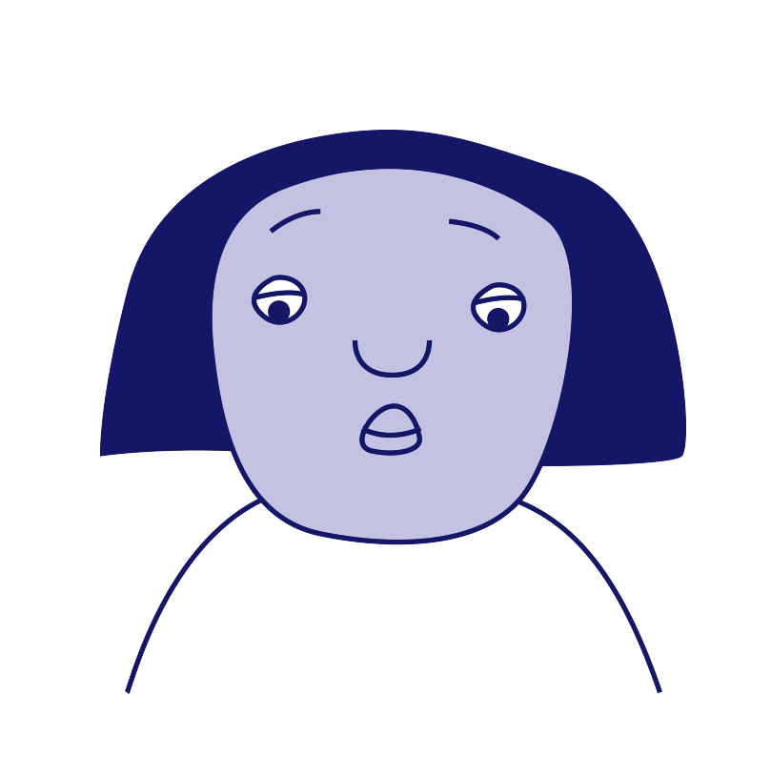
ROLES INVOLVED IN BULLYING
‘Target’
‘Ringleader’
‘Outsider’ or
Bystander’
‘Defender’
‘Reinforcer’
‘Assistant’

Slide 8

DISCUSSION
Have you seen these roles in real life?
Where does the power lie in these roles?
Are these roles fixed or can they change?

Slide 9
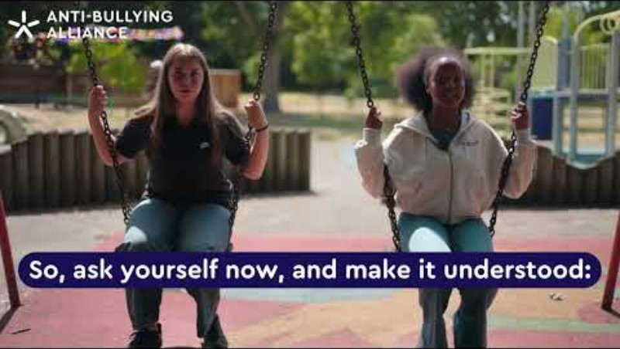
Notes:
https://youtu.be/7b11rdnQsl0

Slide 10
DISCUSSION
What kinds of power did the young people mention
that we might not always notice?
What risks might someone take by standing up to bullying?
Is it realistic to expect young people to speak up?
Whose voices are often left out, and how can we use our power to change that?

Slide 11

GROUP AGREEMENT
ON POWER

Slide 12

PRESENTATION

Slide 13
KEY MESSAGES
How to report bullying;
That everyone has power they can use for good, and;
What other activities are taking place during Anti-Bullying Week.

Slide 14
ANTI-BULLYING WEEK 2025
Monday 10th to
Friday 14th November
Monday 10th November

