Slide 1








ANTI-BULLYING WEEK 2025
Monday 10th to
Friday 14th November
Monday 10th November

Slide 2

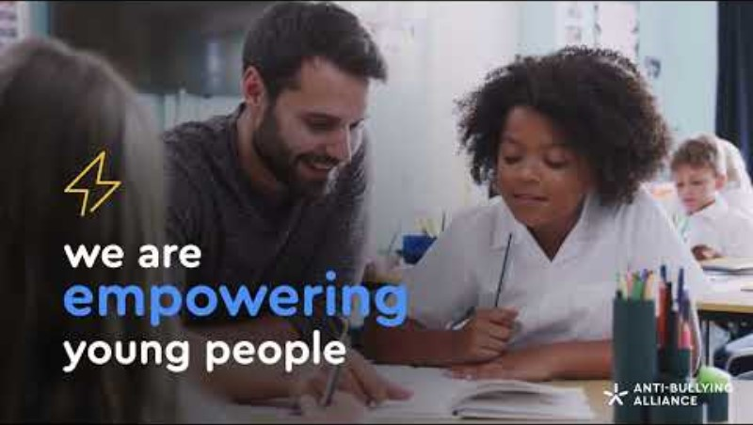

Notes:
https://youtu.be/lO6599wP390

Slide 3


WHAT IS BULLYING?
“
Anti-Bullying Alliance’s Definition:
The repetitive, intentional hurting of one person or group by another person or group, where the relationship involves an imbalance of power. Bullying can be physical, verbal or psychological.
It can happen face to face or online.
“

Slide 4

WHAT IS
BULLYING LIKE?

Slide 5



THE INCIDENT AT THE SCHOOL GATE

Slide 6
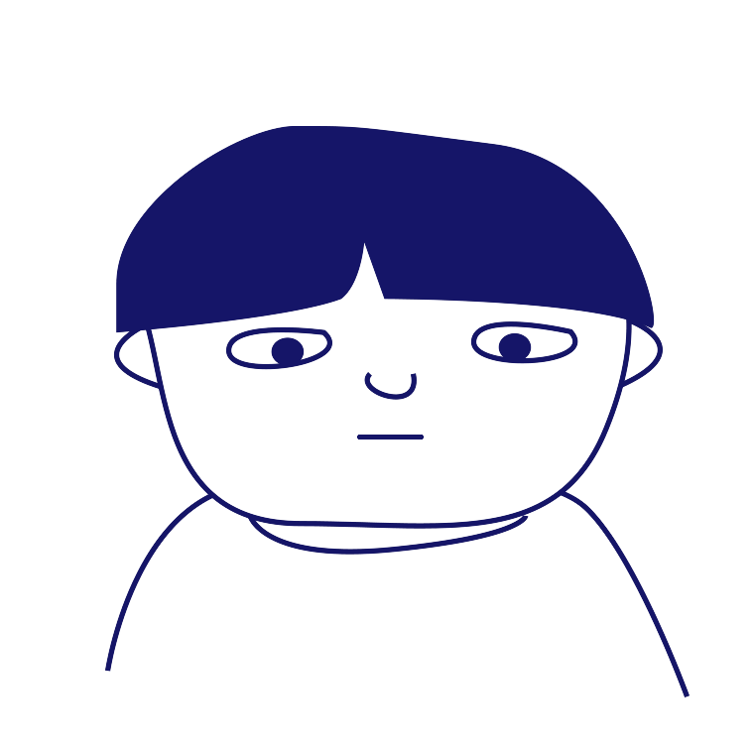

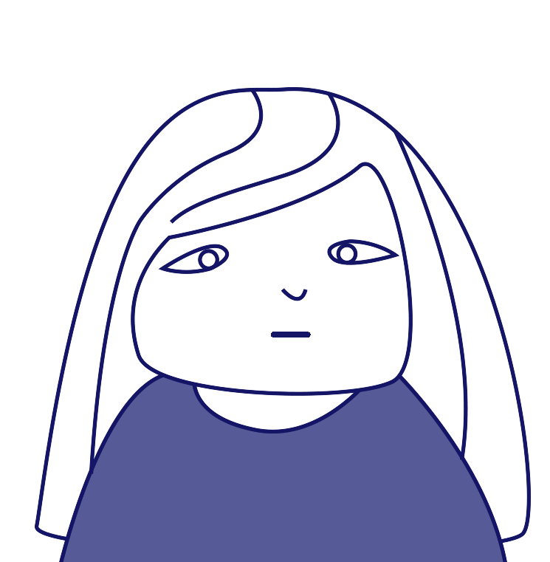
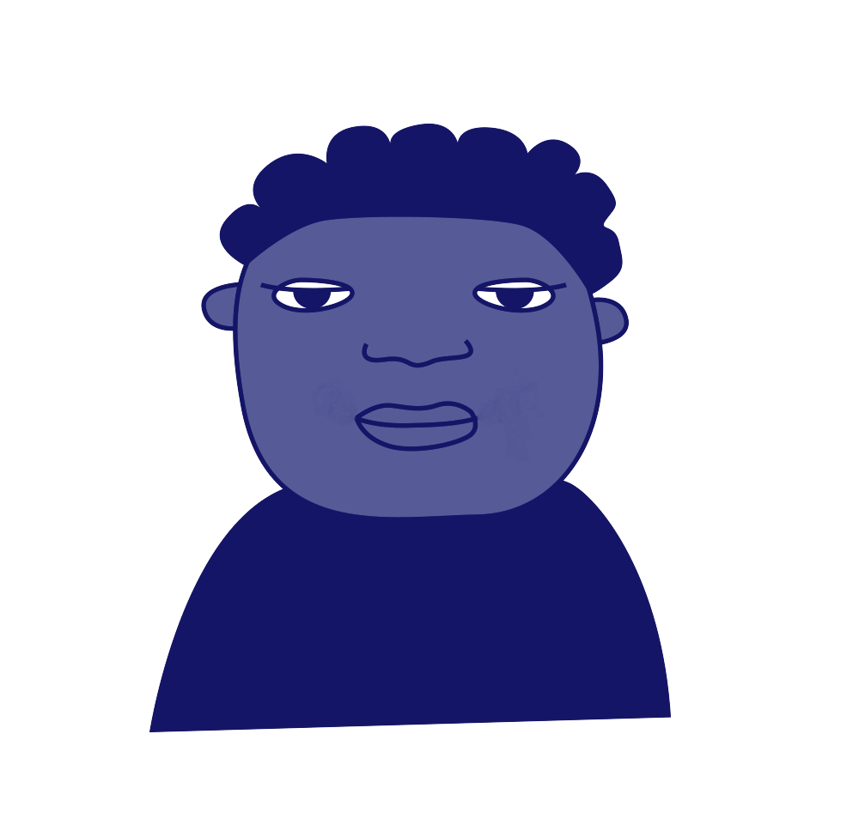
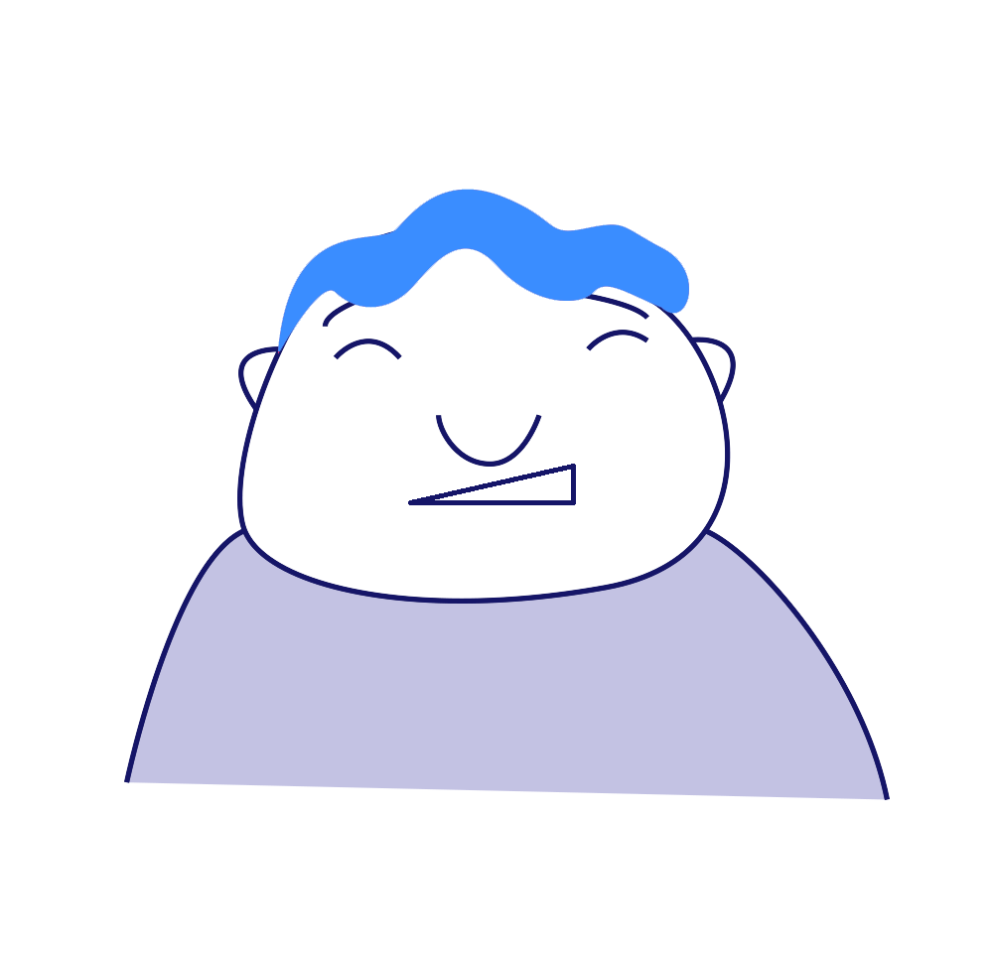
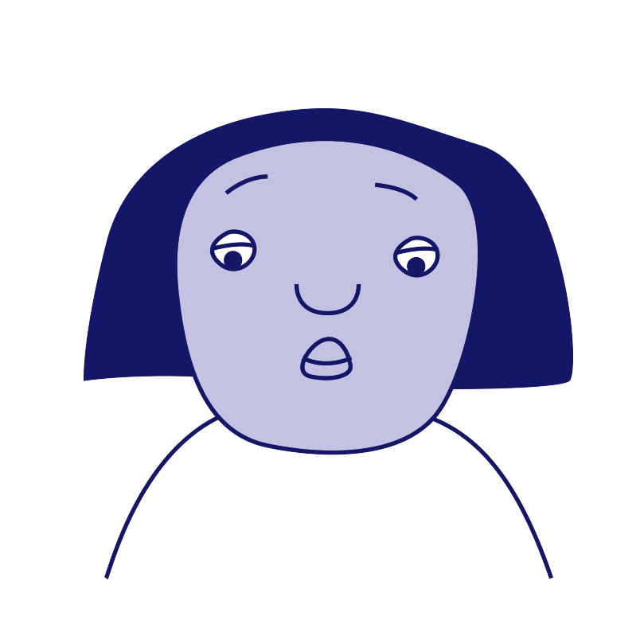
ROLES INVOLVED IN BULLYING
‘Target’
‘Ringleader’
‘Outsider’ or
Bystander’
‘Defender’
‘Reinforcer’
‘Assistant’

Slide 7
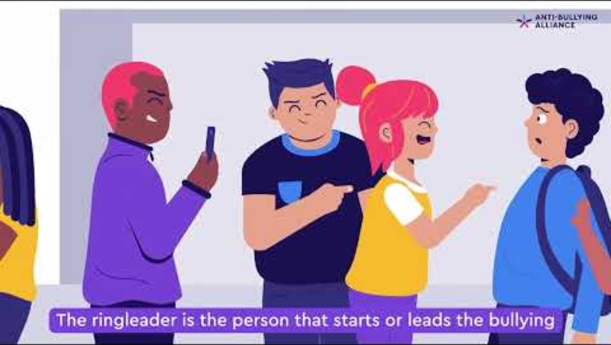
Notes:
https://youtu.be/XcPzUW2GaiY

Slide 8
DISCUSSION
What can you do to make someone feel included?
What could you say if you saw someone being unkind?

Slide 9

KINDNESS AGREEMENT

Slide 10

RECAP

Slide 11
ANTI-BULLYING WEEK 2025
Monday 10th to
Friday 14th November
Monday 10th November

