Slide 1






Odd Socks Day whole-school activity
Anti-Bullying Week 2025

Slide 2



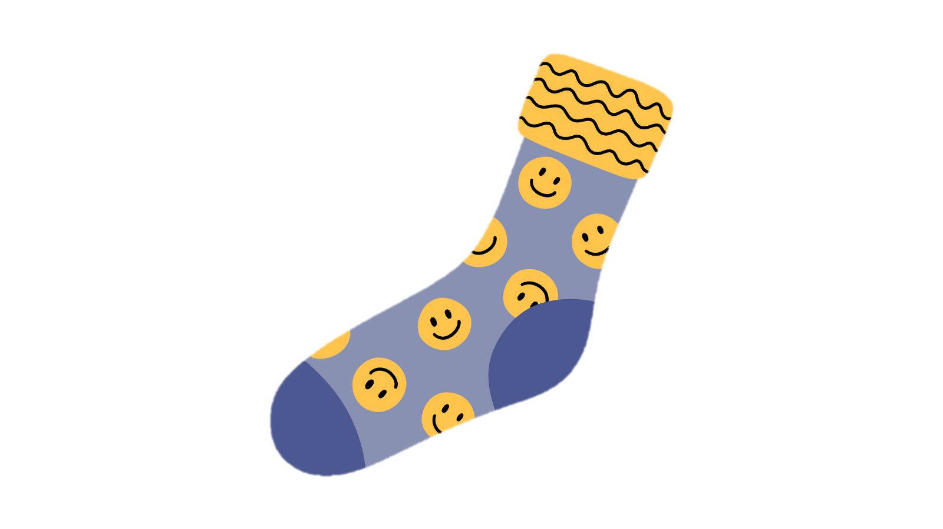

Show off your odd socks!

Slide 3


Our Socks
Our socks don’t match, and that’s okay
We’re all unique in our own way
Be kind, be fair, help friends each day
That’s how we use our power for good, hooray!

Slide 4
Our kindness sock

Slide 5






Kindness actions

Slide 6

Anti-Bullying Week 2025
Monday 10 to
Friday 14 November
Monday 10November

