Slide 1



ANTI-BULLYING WEEK 2024

Slide 2
CALL TO ACTION
From playgrounds to the Senedd, our homes to our phones, this Anti-Bullying Week let's 'Choose Respect' and bring an end to bullying which negatively impacts millions of young lives.
This year, we’ll empower children and young people to not resort to bullying, even when we disagree and remind adults to lead by example, online and offline.
Imagine a world where respect and kindness thrives — it’s not just a dream, it's in the choices we make. Join us this Anti-Bullying Week and commit to 'Choose Respect'. What will you choose?

Slide 3
“
WHAT IS BULLYING?
Anti-Bullying Alliance’s Definition:
The repetitive, intentional hurting of one person or group by another person or group, where the relationship involves an imbalance of power. Bullying can be physical, verbal or psychological.
It can happen face to face or online.
“

Slide 4

Ground Rules

Slide 5

“
CHOOSE RESPECT POEM
Choose Respect, it’s Fundamental,
Essential in life and elemental,
Without it, relationships can be temperamental,
Which can end up being detrimental.
“

Slide 6
“
WHAT IS RESPECT?
Oxford Languages definition:
Have due regard for (someone’s feelings, wishes, or rights).
“

Slide 7

?
Is respect something that is earned?

Slide 8

?
What does respect mean to me?

Slide 9
“
CHOOSE RESPECT POEM
Choose to Respect everyone’s perspective,
A difference in opinion, that’s our prerogative. Listen to others and be appreciative,
Rather than inconsiderate and argumentative.
“

Slide 10

GROUP DISCUSSION
Is it possible to disagree and argue respectfully without resorting to bullying?
Is it important that we know how to disagree respectfully without resorting to bullying?

Slide 11
THE YOUNG ABA’S THOUGHTS ON IF IT IS POSSIBLE TO DISAREE AND REMAIN RESPECTFUL
“I think respect is always a choice.”
“Respect is just another word for being kind.”
“I would say that respect goes both ways.”
“To respect people you don’t like, you just don’t interact with them really.”
“You might need to step away from the situations sometimes.”
“I try to listen to what the other person is saying and try to keep an open mind.”

Slide 12
TASK
Your top 5 Choose Respect tips

Slide 13

OUR TOP CHOOSE RESPECT TIPS
1) Active listening
2) Use "I" statements
3) Stay calm and take breaks
4) Focus on behaviour, not character

Slide 14
OUR TOP CHOOSE RESPECT TIPS
5) Seek common ground
6) Agree to disagree
7) Don't resort to making things personal
8) Reflect and learn

Slide 15
“
CHOOSE RESPECT POEM
Choose to respect the disrespectful,
Don’t allow them to feel powerful.
Don't fight back with words that are hurtful,
Or act impulsively and end up regretful.
“

Slide 16

TASK
Reverse the Clock

Slide 17
“
CHOOSE RESPECT POEM
Choose to respect the disrespected,
Respect is something that is reflected.
Respect can prevent someone from feeling rejected,
Respect is a cycle that is interconnected.
“

Slide 18
“
CHOOSE RESPECT POEM
Choose to make respect an easy decision.
I choose, you choose, we choose respect.
“

Slide 19
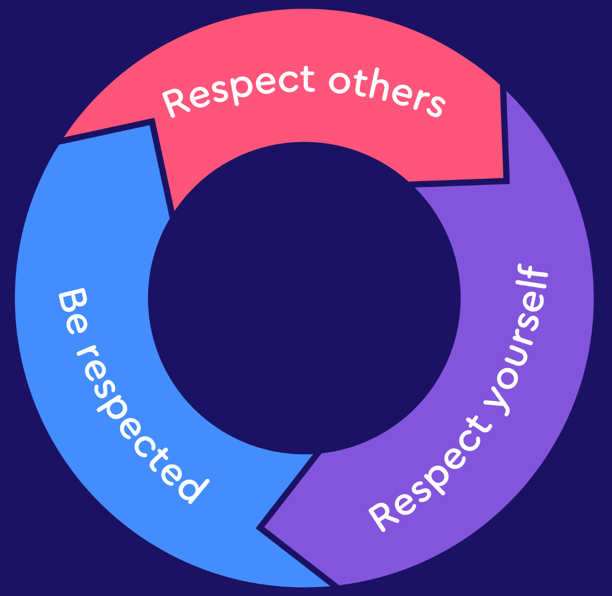
RESPECT IN ACTION
Demonstrating respect for others, self-respect, and being respected are interlinked elements essential for fostering healthy and positive interactions.

Slide 20

WHO CAN YOU SPEAK TO AT SCHOOL?
Staff name here
Staff name here
Staff name here

Slide 21



ANTI-BULLYING WEEK 2024
Monday 11th to
Friday 15th November
Odd Socks
Day 2024
Tuesday 12th November

