Slide 1



ANTI-BULLYING WEEK 2024

Slide 2
CALL TO ACTION
From playgrounds to parliament, our homes to our phones, this Anti-Bullying Week let's 'Choose Respect' and bring an end to bullying which negatively impacts millions of young lives.
This year, we’ll empower children and young people to not resort to bullying, even when we disagree and remind adults to lead by example, online and offline.
Imagine a world where respect and kindness thrives — it’s not just a dream, it's in the choices we make. Join us this Anti-Bullying Week and commit to 'Choose Respect'. What will you choose?

Slide 3


https://youtu.be/sZ_CkltlgS4

Slide 4
“
WHAT IS BULLYING?
Anti-Bullying Alliance’s Definition:
The repetitive, intentional hurting of one person or group by another person or group, where the relationship involves an imbalance of power. Bullying can be physical, verbal or psychological.
It can happen face to face or online.
“

Slide 5

?
How well do we, as a society, show respect to one another?

Slide 6

“
WHAT IS RESPECT?
Oxford Languages definition:
Have due regard for (someone’s feelings, wishes, or rights).
“

Slide 7
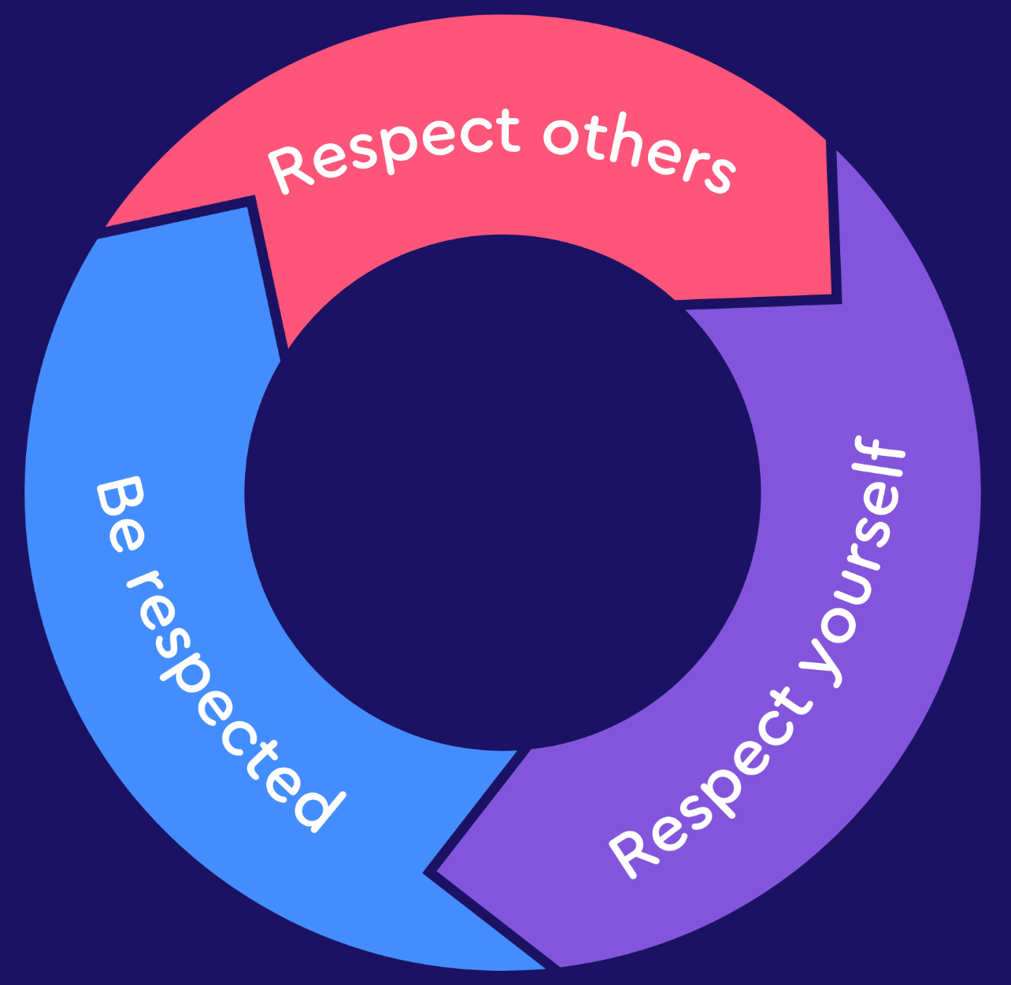
RESPECT IN ACTION
Demonstrating respect for others, self-respect, and being respected are interlinked elements essential for fostering healthy and positive interactions.

Slide 8

WHO CAN YOU SPEAK TO AT SCHOOL?
Staff name here
Staff name here
Staff name here

Slide 9



ANTI-BULLYING WEEK 2024
Monday 11th to
Friday 15th November
Odd Socks
Day 2024
Tuesday 12th November

