Slide 1


Anti-Bullying
Week 2021
Primary School Assembly

Slide 2
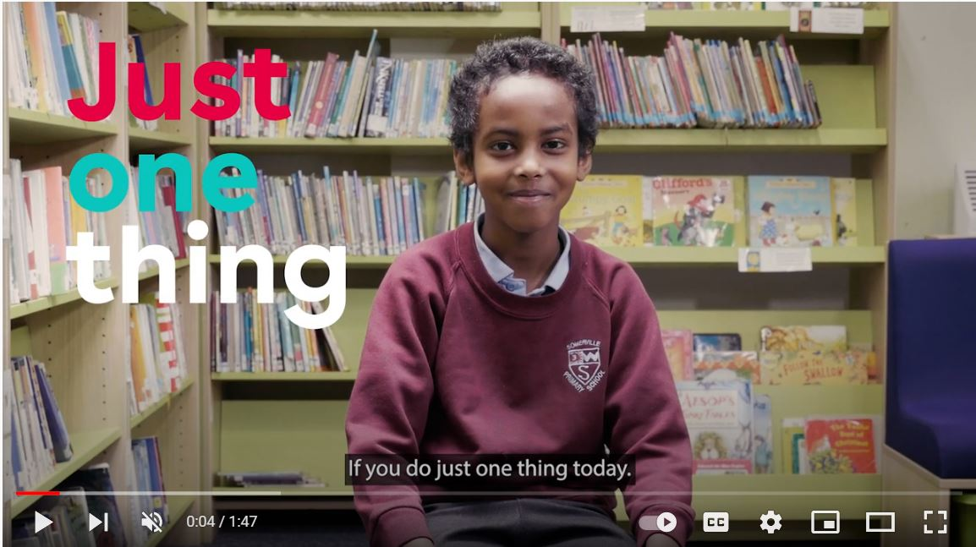


“
“
https://youtu.be/oJQg2JyQ3mM
Anti-Bullying Week 2021 – One Kind Word
2

Slide 3
?
Think of a film or TV programme where kindness saved the day
Think / Pair / Share
Anti-Bullying Week 2021 – One Kind Word
3

Slide 4
?
What will you do to start our ripple effect of kindness?
Think in pairs about how you can show people kindness in school and at home this week
Anti-Bullying Week 2021 – One Kind Word
4

Slide 5
Who can help us in our school?
1
2
3
Staff Name here
Staff Name here
Staff Name here
Anti-Bullying Week 2021 – One Kind Word
5

Slide 6
Thank you for being a part of
Anti-Bullying
Week 2021

